Slide 1


Slide 2

2

Slide 3

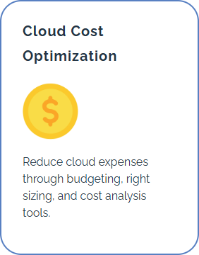
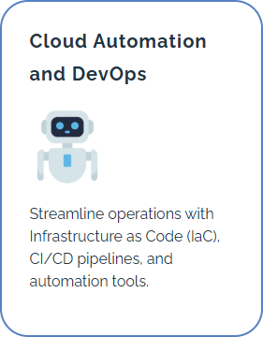



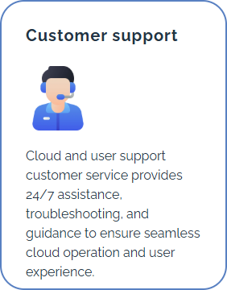
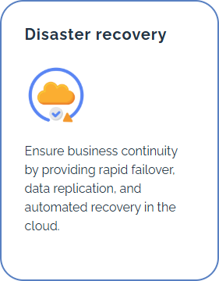
Out sourcing
In country sourcing
Consulting
3

Slide 4
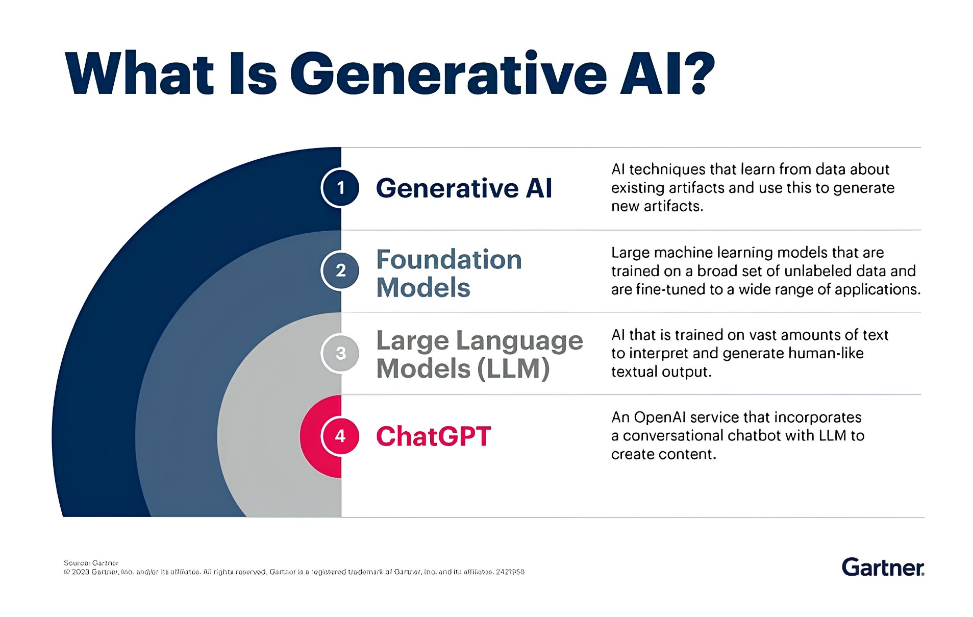
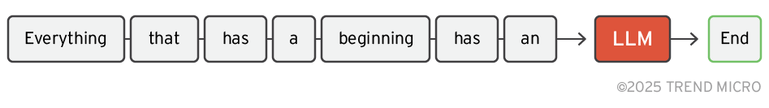
Ground work

Slide 5
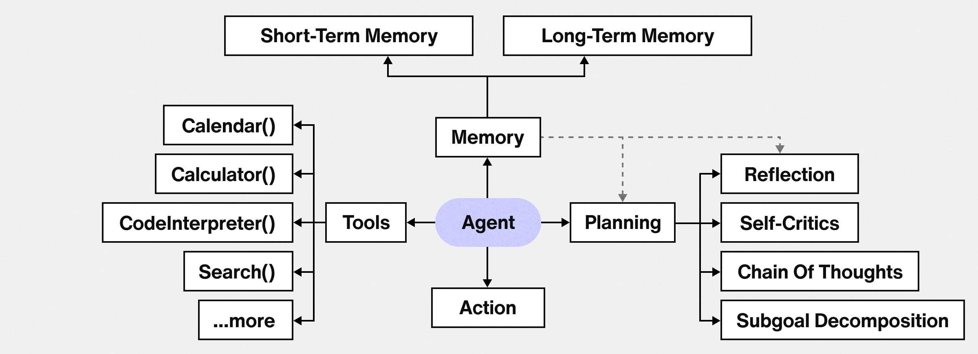
What are AI agents
AI agents are fully autonomous systems designed to act independently, usually making decisions without human intervention. They don’t just follow instructions - they assess, adapt, and execute.
Source: https://sendbird.imgix.net/cms/How-to-build-an-AI-agent_diagram.png

Slide 6
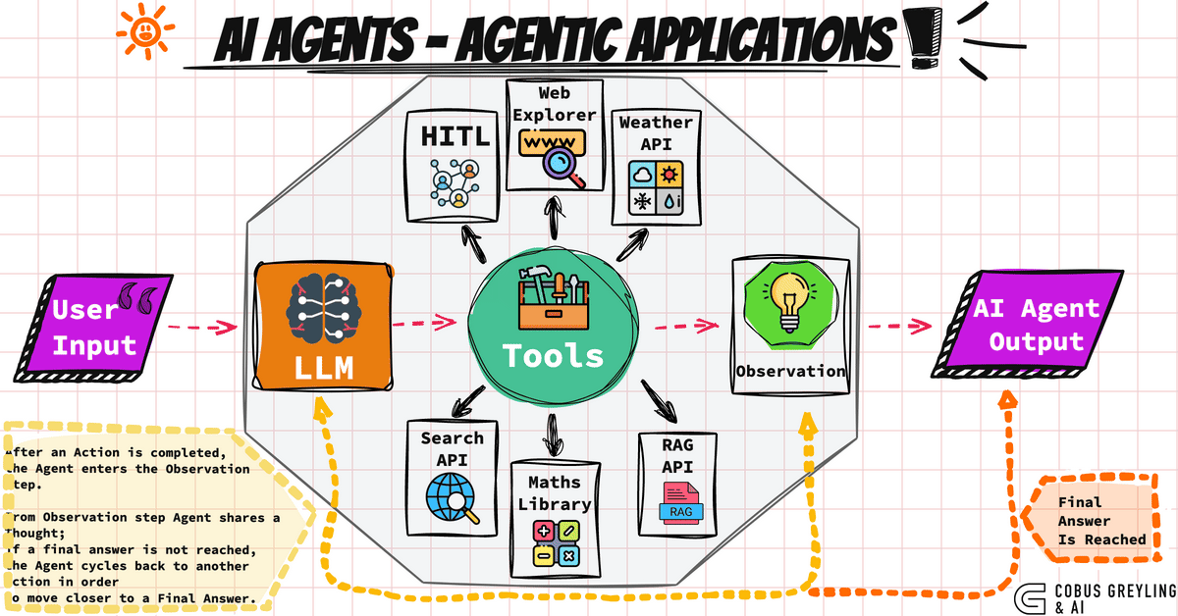

Slide 7
Examples
Domain | AI Assistant | AI Agent | Agentic AI
Productivity | Microsoft Copilot | Zapier AI Actions | Devin (Cognition)
Customer Service | Intercom Chatbot | DoNotPay | Klarna AI Assistant (advanced version)
Navigation | Google Maps Assistant | Waymo Autonomous Taxi | Future Tesla FSD (v12+)
Software Dev | ChatGPT Code Interpreter | GitHub Copilot | AutoGPT
Logistics | Alexa (voice-activated tracking) | Starship Delivery Robot | Autonomous Warehouse Agents (e.g., Covariant)
Cybersecurity | Security Copilot (basic) | Darktrace Autonomous Response | Microsoft Security Copilot (full vision)
E-commerce | Amazon Recommender | Shopify AI Checkout Bot | AutoGPT-powered Business Builder
Robotics | iRobot with voice commands | Boston Dynamics Spot with missions | Self-directed humanoid robot (e.g., Figure AI future)

Slide 8
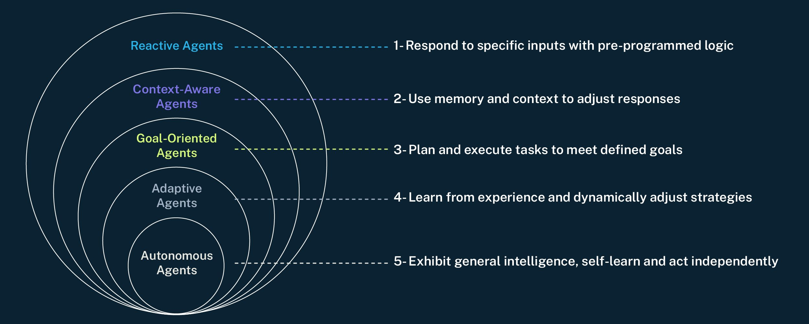
Types of AI Agents
Source: https://www.cyberark.com/resources/blog/the-rise-of-ai-agents-collaborative-intelligence

Slide 9
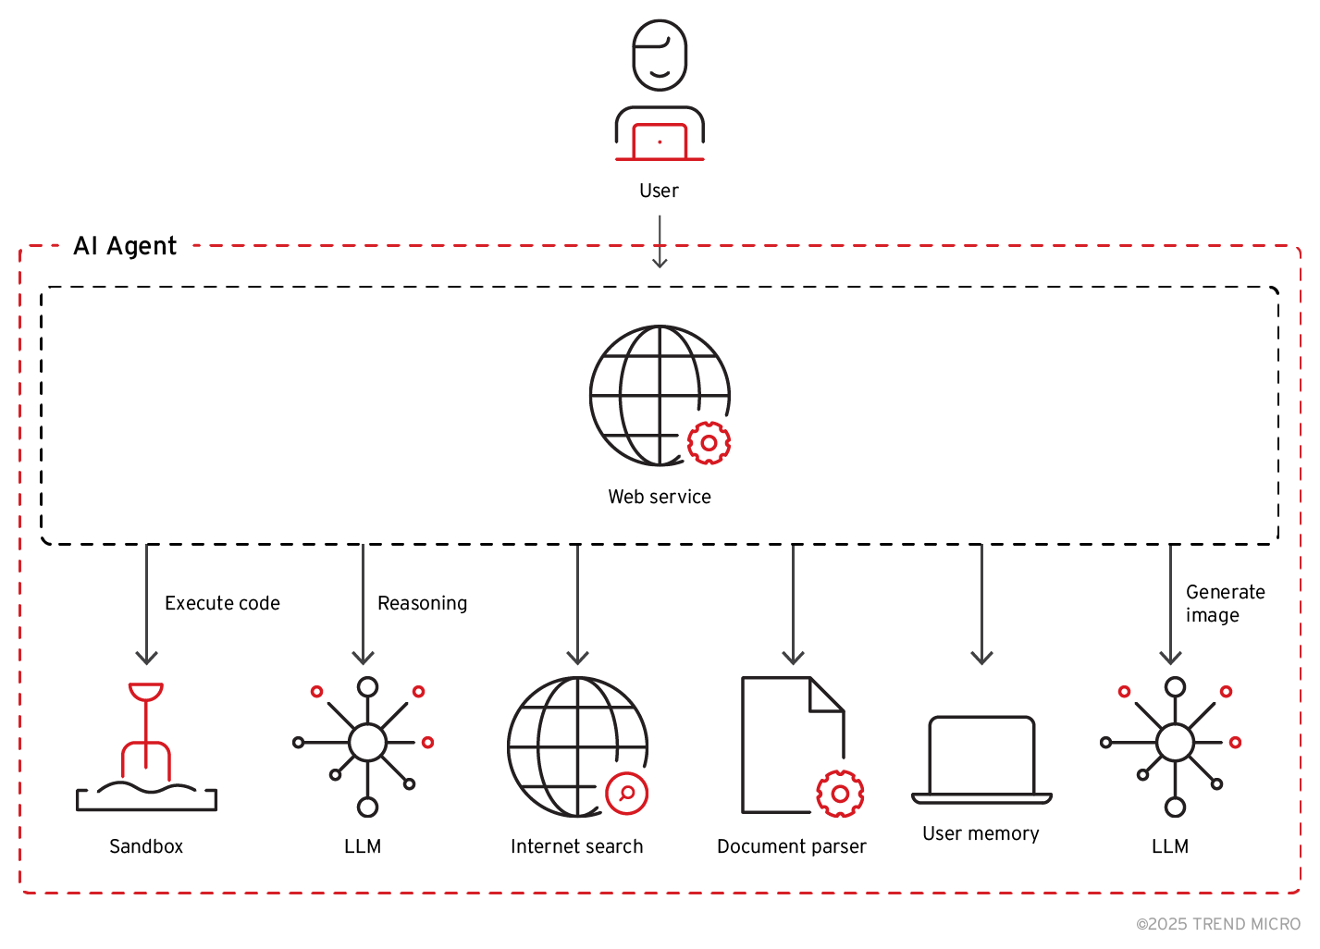
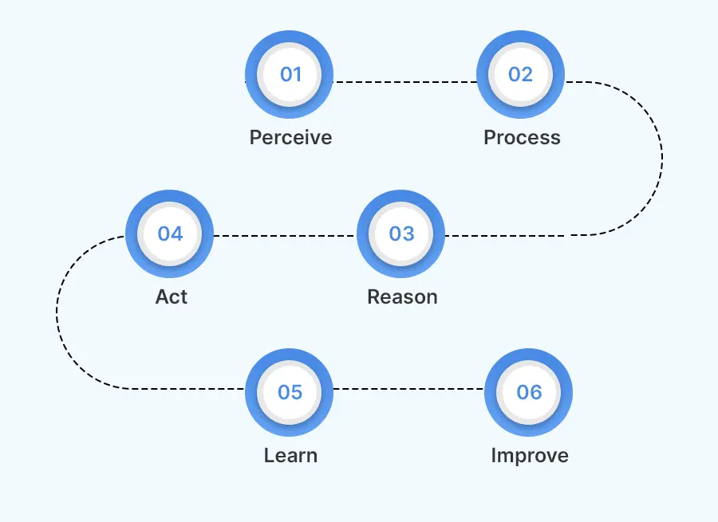
AI agent process
Source: https://botpenguin.com/glossary/ai-agent
Source: https://www.trendmicro.com/vinfo/us/security/news/threat-landscape/unveiling-ai-agent-vulnerabilities-part-i-introduction-to-ai-agent-vulnerabilities?utm_source=chatgpt.com

Slide 10
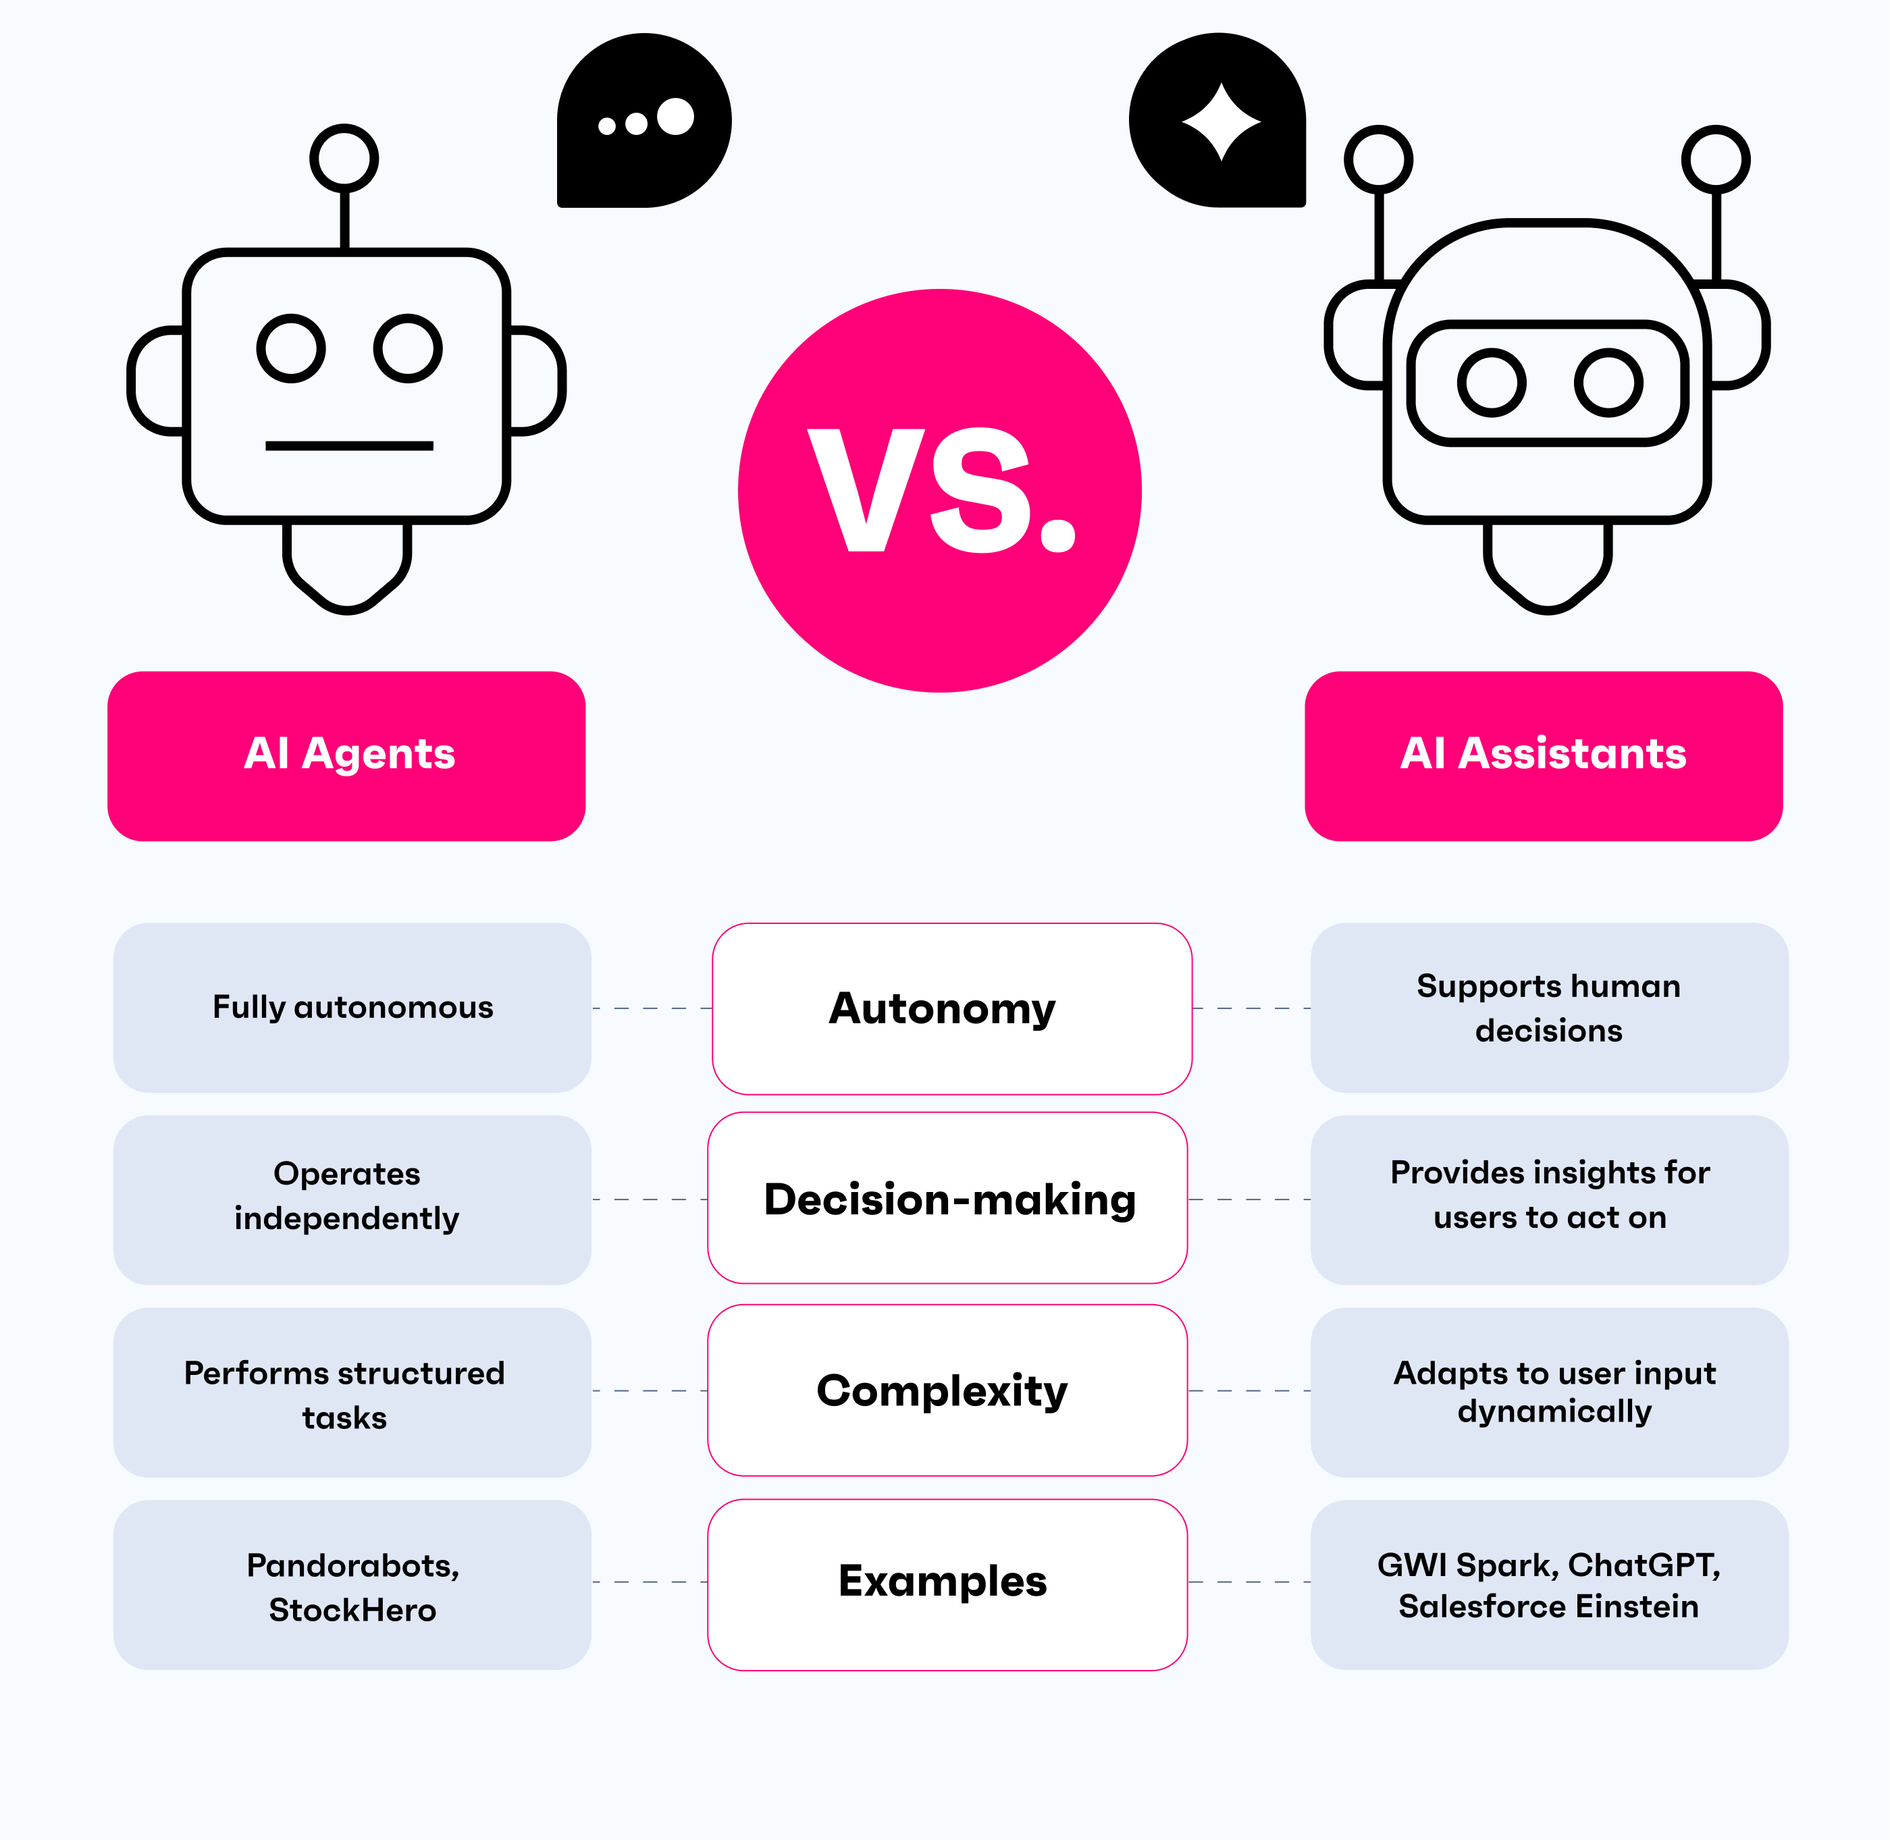
Differences
Feature / Aspect | AI Assistant | AI Agent | Agentic AI
Definition | A tool that performs tasks in response to user input | An autonomous system that performs user-defined tasks | A highly autonomous system with its own planning, goals, and memory
Initiative | Reactive – waits for commands | Semi-autonomous – executes given instructions | Proactive – acts independently toward dynamic goals
Memory | Short-term or session-based | May retain task-specific memory | Long-term memory of goals, plans, interactions
Goal-setting | None – user sets tasks | Executes predefined goals | Sets and adjusts goals based on context
Autonomy Level | Low | Medium | High
Planning & Reasoning | Minimal | Stepwise or reactive planning | Multi-step planning with self-reflection
Tool Usage | Limited or user-directed | Can use predefined tools | Uses multiple tools independently, including chaining across systems
User Interaction Style | Command → Response | Task assignment → Output | Mission setup → Independent operation
Typical Scope | Single-turn or basic multi-turn | Narrow domain-specific tasks | Open-ended tasks with uncertain paths
Level of Control | High – user-driven | Medium – user guides & supervises | Low – user defines boundaries, agent acts independently
Safety Risks | Low – mostly user-controlled | Moderate – task misuse or failure | High – emergent behaviors, autonomy risks, value misalignment
Source: https://www.gwi.com/blog/ai-agent-vs-ai-assistant

Slide 11
Challenges with Gen AI Agents
Expanded attack surface
With High Access and High Autonomy
Existing
Generative AI
risks
(Ethical, privacy, misinformation, regulations, prompt injection etc...)
Context Misunderstanding
Autonomy
Over Reliance
Access
BIAS amplification

Slide 12
The real danger: Is AI even Real?
🍎 “The Illusion of Thinking” by Apple (arXiv:2506.06941, June 7, 2025)
Authors: Shojaee, Mirzadeh, Alizadeh, Horton, Bengio, Farajtabar
Core claim: Large Reasoning Models (LRMs) that generate detailed chains-of-thought still collapse completely on sufficiently complex planning puzzles (e.g., Tower of Hanoi, River Crossing).
They define three performance regimes based on problem complexity: simple (LLMs > LRMs), medium (LRMs shine), and high (both fail)
Notably, reasoning effort grows with difficulty until a tipping point—after which it declines, indicating that models “give up” despite available tokens
They suggest LRMs lack generalizable algorithm-following and exact computation beyond a certain scale
🤖 2. “The Illusion of the Illusion of Thinking” by Anthropic / Open Philanthropy (arXiv:2506.09250, June 10, 2025)
Authors: C. Opus (Anthropic), A. Lawsen (Open Philanthropy)
Key rebuttals:
Token-limit artifacts: Models explicitly recognize output length constraints (e.g., “I’ll stop here to avoid…”)—but evaluation misinterprets this as reasoning failure
Impossible puzzles included: Many River Crossing instances were unsolvable (e.g., N>5 with boat too small), yet failures were counted as reasoning flaws
Evaluation misattribution: When models were tasked with generating solution-generating functions (instead of full lengthy sequences), they performed well even on previously “collapsed” Tower of Hanoi tasks

Slide 13


Slide 14
Solutions? Mitigations?
Guardrails & Input‑Output Filters (e.g. Llama Guard)
Human‑in‑the‑Loop (HITL): Reject automatic action → escalate to human
Secure Architecture & Monitoring: sanitize inputs, limit tool access, log behaviors
Governance & Audits: regular bias and privacy reviews for deployed agent systems

Slide 15
Sources
Agent-SafetyBench: Evaluating the Safety of LLM Agents
Unveiling AI Agent Vulnerabilities Part I: Introduction to AI Agent Vulnerabilities
Here Come the AI Worms
Safeguarding AI Agents: Developing and Analyzing Safety Architectures
HAICOSYSTEM: An Ecosystem for Sandboxing Safety Risks in Human-AI Interactions
Intelligent Agent
Adversarial Misuse of Generative AI
Demo: Damn Vulnerable LLM Agent
Apple paper: The Illusion of Thinking Anthopic response: The Illusion of the Illusion of Thinking A Comment on Shojaee et al. (2025)

